Slide 1
Voice Assistant For Indian Knowledge Systems
HT5073: Speech recognition for Indian Languages
Project Presentation
Sai Kasyap Kamaraju
(HT23RESCH04001)
Notes:
31 Authors in the paper.

Slide 2
Agenda
Introduction
High Level Architecture
Open AI Whisper ASR Model
Whisper Architecture
Architecture of NLU
NLU model & Types of Searches
Conclusion & Future applications

Slide 3
Introduction
Motivation : Can we replicate/build voice assistant (SLU) systems using open source technologies?
Can we build voice assistants for low resource Indian languages like hindi and around Indian heritage?
Search using custom search engine
Voice chat with specific books ..
An attempt has been made to address the above challenges ..
Notes:
Talk about GPT1, GPT2.

Slide 4
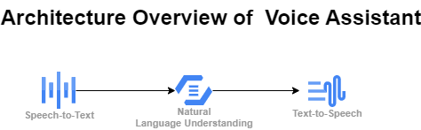
High level Architecture
A Pretrained ASR Whisper model is used for transcribing recorded speech to text.
Combination of Semantic search and LLM is used to build the NLU to give the answer based on the query.
TTS (FastPitch & HifiGAN) Model API is used to speak the answer given by the NLU.

Slide 5
Open AI Whisper ASR Model
●Whisper is an automatic speech recognition (ASR) system trained on 680,000 hours of multilingual and multitask supervised data collected from the web. One-third of whisper’s dataset is non-english.
●It has added robustness to accents,background noise and technical sound analysis and modelling.
●It has enabled transcription for multiple languages.
●It does a good job on transcribing the audio in its original language or translating to english.
●It does a good job in learning speech to text task and has outperform the supervised SOTA on CoVoST2 to English zero-shot.
●Whisper’s zero-shot performance across diverse dataset is better because it was trained in that fashion.
●It is not fine-tuned on any particular dataset hence it does not beats the LibriSpeech benchmark but when tested on diverse datasets it is better.

Slide 6
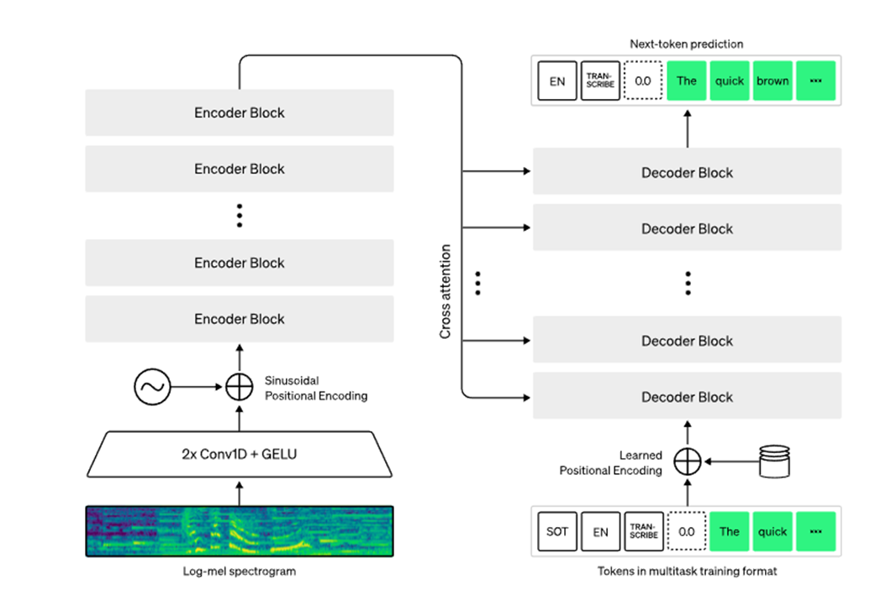
Whisper Architecture
●It is implemented as encoder-decoder architecture.
●It takes in 30-second chunks of audio input and converts into a log-Mel spectrogram
●Decoder predicts corresponding text captions.
●Special tokens have been added which helps in performing further tasks like language identification, phrase-level timestamps, multilingual speech transcription, and to-English speech translation.

Slide 7
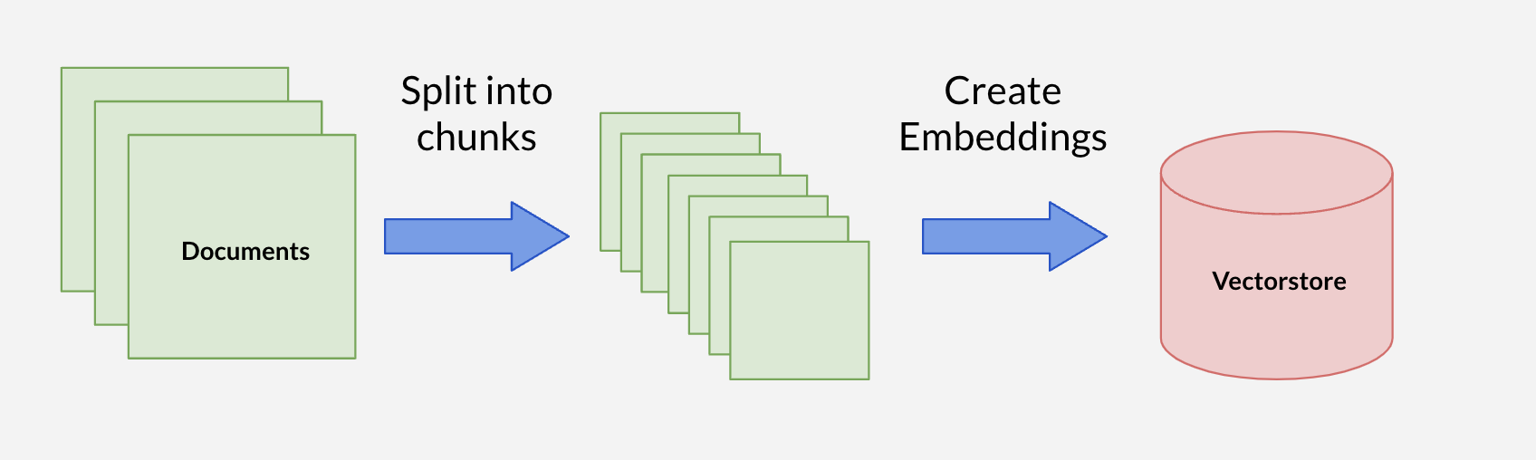
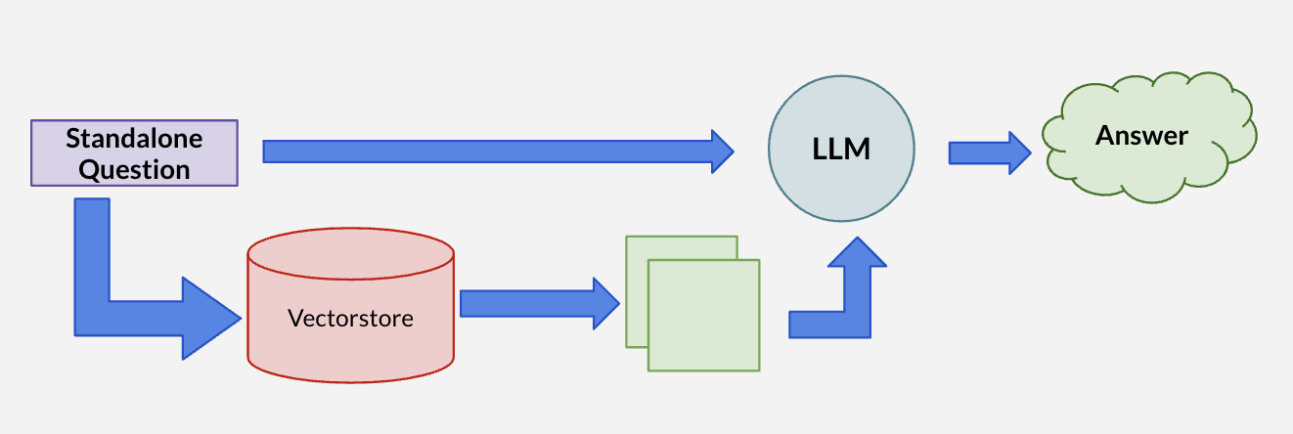
ARCHITECTURE OF NLU

Slide 8
NLU models & Others
LLMs model variants based on T5 Transformer architecture are used in this project.
Various Embedding models are tried to store the text in to the Vector DB.
Facebook’s Faiss is used as Vector Database to store the Embedding Vectors.
For TTS, AI4Bharat API is used to output the speech result.
Various searches like DuckDuckGo, Wikipedia, Books based on Ramayana & Mahabharata have been incorporated for English.
For Hindi, Only the translation of shoklas of Ramcharit Manas Valimiki Ramayana is used.

Slide 9
Conclusion & Future Steps
Conclusion:
Voice Assistant for English using Wikipedia , DuckDuckGo Search, Ramayan and Mahabharat pdf books works ok.
A Successful attempt has been made to build SLU systems using open source technologies.
Scope :
There is a scope of improvement for Voice Assistant for Hindi language.
Evaluation of Voice Assistant for each of the Indic language based on benchmarking datasets like SQuAD needs to be considered.
Finetune the ASR model for Indian English and other Indic languages.
Evaluation of fine tuned ASR & TTS models.
Test various other LLMs and Embeddings for different Indic languages and Heritage Scripts to improve the performance better.
Incorporate Reinforcement Learning and chat history for the SLU.
Exploring other searches and tools that could be incorporated in to the SLU.
Test it on the SLU on benchmark datasets like IndicSUPERB.

Slide 10
DEMO TIME

